Slide 1
Paragraph Writing
Elements and Methods

Slide 2
Paragraph Development
A group of sentences or a single sentence that forms a unit to express a single idea is called a paragraph.
A paragraph consists of several related sentences and deals with one controlling idea.
The main function of a paragraph is to develop, support, exemplify or explain the controlling idea or topic.

Slide 3
An Effective Paragraph
Presents a single idea
Begins with a topic sentence that makes this single idea evident
Contains support in the form of sentences that convey this single idea
Three parts - Topic, Support, Conclusion
Is strategically organized to maintain flow
Maintains the essay’s objective
Informs the reader about the paper’s overall idea

Slide 4
Techniques/Components/Elements
The central components of a paragraph are –
Topic Sentence
Unity
Coherence
Emphasis
Adequate Development

Slide 5
Topic Sentence
A topic sentence is a sentence that expresses the main idea of a paragraph which will be developed in the paragraph.
It is also known as the key sentence or the theme sentence.
It may be written in the form of a simple, complex or compound sentence, depending on the need and scope of the paragraph.
A topic sentence is mostly placed at the beginning (deductive) or end (inductive) of a paragraph and in rare instances can be found in the middle(creative writing) of the paragraph

Slide 6
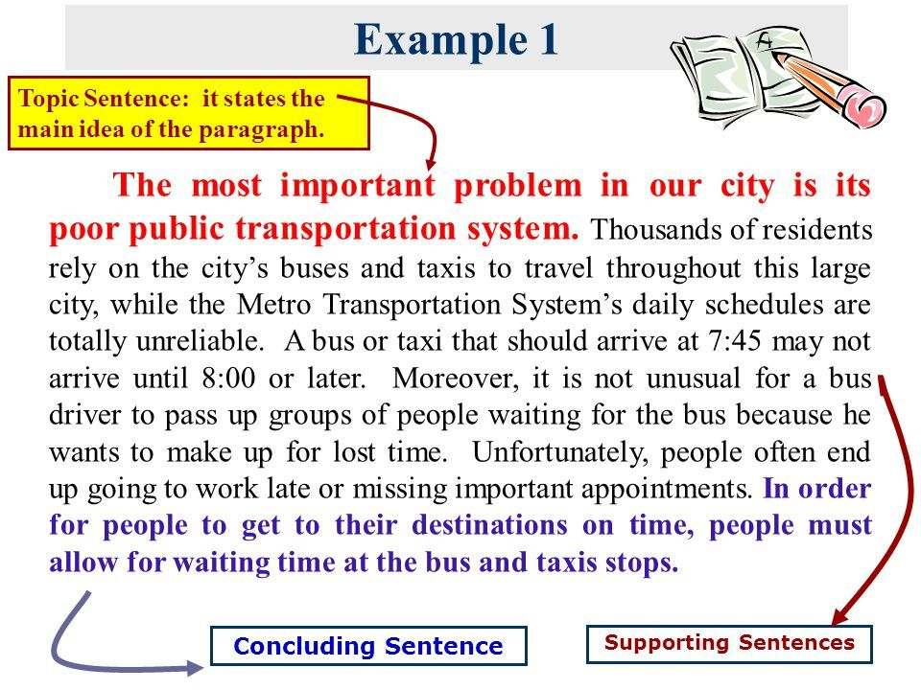
Topic Sentence - Beginning

Slide 7

Topic Sentence - Ending

Slide 8
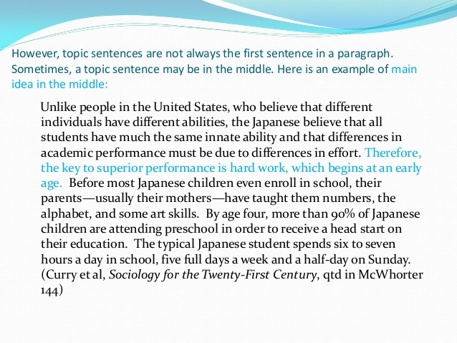
Topic Sentence - Centre

Slide 9
Unity
Unity means that the components deal with one main idea or thought.
The ideas contained within a paragraph ‘hang together’ in a way that is easy for the reader to understand.
A paragraph is a logical division of the central theme of a longer piece of writing.
Each sentence in the paragraph is directly related to the central idea or theme and contributes to its development.
Only one main thought should be expressed in a paragraph to maintain unity.

Slide 10
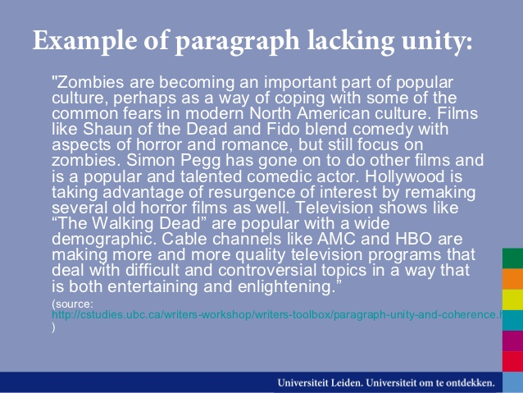
NO Unity

Slide 11
Coherence
Coherence is consistency of speech, thoughts, ideas and reasoning which makes the expression clear and easy to understand.
It refers to clear and logical linking of ideas in a paragraph.
In cohesive paragraphs, ideas are linked and one idea logically leads to the next.
Coherence is closely related to unity as when more than one idea is incorporated in a paragraph, coherence goes missing.

Slide 12
Mechanical Devices for Coherence – 4 Tools
Uses of pronouns –Pronouns connect ideas as they refer the reader to something earlier in the text.
Use of transitional tags/linkers – They help in transition of ideas. Transitional tags can vary from simple conjunctions like but, and, yet, etc. to complex conjunctive adverbs like however, moreover, etc.
Repetition of key words and phrases – Repetition of certain words also give coherence to a paragraph. While using repetition the writer must be very careful because too much repetition may lead to monotony and redundancy.
Use of parallel grammatical structure–Parallelism means same grammatical form. To attain coherence, same grammatical form and style should be maintained in all the sentences as well as the paragraph.

Slide 13
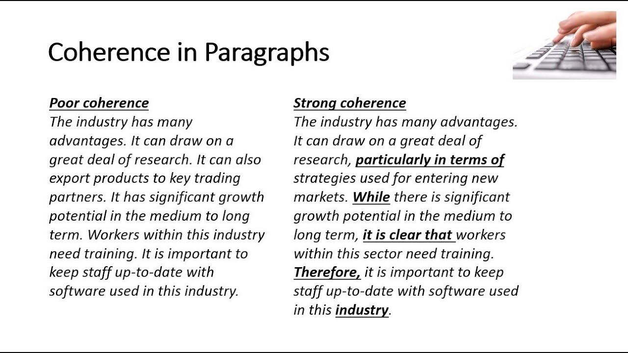
Example of Coherence

Slide 14
Emphasis
Emphasis is the principle of the paragraph composition in which the important ideas are made to stand.
Sentence emphasis refers to idiomatic stress in writing.
It is important to know how to place important words in emphatic positions in order to make it effective.

Slide 15
Tools for Emphasis – 4 Tools
Emphasis by position - It means that the writer should give special attention to the beginning as well as the ending of a paragraph and place the points to be emphasized in these two positions.
Space and emphasis – It means to give more space to the idea to be emphasized.
Sentence structure and Emphasis – Important points should be paced in short and simple sentences. Emphasis may be achieved by repeating some keywords or by introducing synonyms of words.
Mechanical means of emphasis – Some mechanical devices like “quotation marks”, italics, boldface, highlighting, underlining, etc. can also be used to emphasize.

Slide 16
Adequate Development
A paragraph is adequately developed when it describes, explains and supports the topic sentence.
If the "promise" of the topic sentence is not fulfilled, or if the reader is left with questions after reading the paragraph, the paragraph has not been adequately developed.
Generally speaking, a paragraph which consists of only two or three sentences is under-developed.
A good rule of thumb to follow is to make sure that a paragraph contains at least four sentences which explain and elaborate on the topic sentence.

Slide 17
Lacking Adequate Development-Example
"The topics of leadership and management are both similar to and different from one another in several important ways. To be effective, a manager should be a good leader. And good leaders know how to manage people effectively."

Slide 18
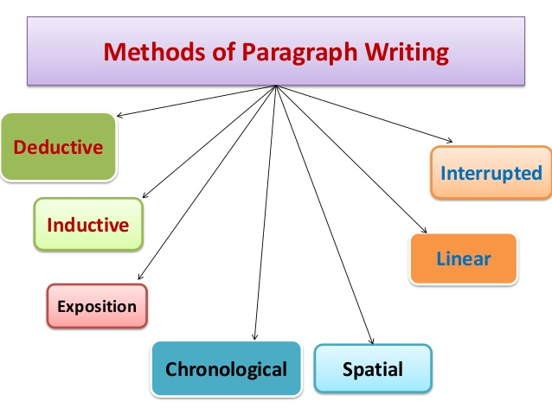
Methods/Orders/Types of Paragraph

Slide 19
Inductive Order
It is an objective and logical technique in which information is organized in a specific/particular to general organization.
In this logical organization, specific details, examples and illustrations are given first then a general statement or generalization is made.
The topic sentence comes at the end of the paragraph.

Slide 20
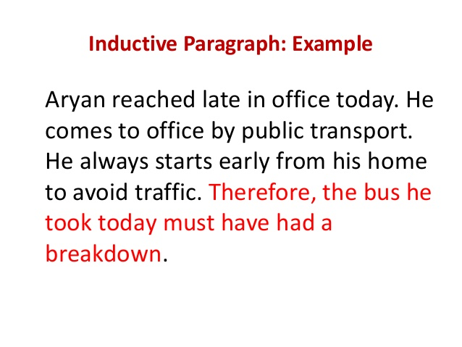

Slide 21
Deductive Order
It is the most common logical organization which involves the process of moving from a general statement or principle to specific details.
It is the most popular form amongst the writers.
The topic sentence is usually the first sentence in this type of order.

Slide 22
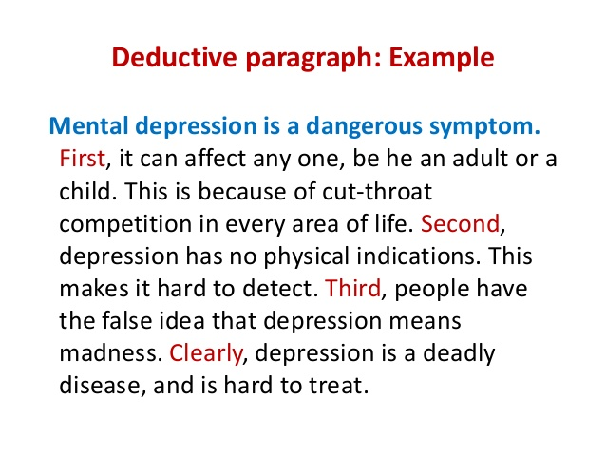

Slide 23
Spatial Order
It is the simplest logical organization which involves the process of dividing a subject or topic based on how they are arranged in space.
It is the area-wise or three-dimensional description.
This pattern can make a complex subject easy to understand by categorizing its various elements spatially.
It is mostly used by technocrats in the description of machines.

Slide 24
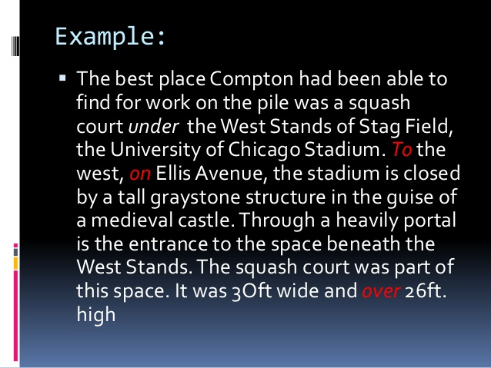
Example of Spatial Order

Slide 25
Linear Order
Linear means ‘consisting of lines’ or ‘one dimensional’.
Each sentence leads to the next one in a paragraph with the purpose of maintaining a forward movement; and each paragraph can be a step to take us to a goal.
It refers to the systematic order as a line which involves presenting ideas in a progressive way where sentences are connected to each other in a logical way.

Slide 26
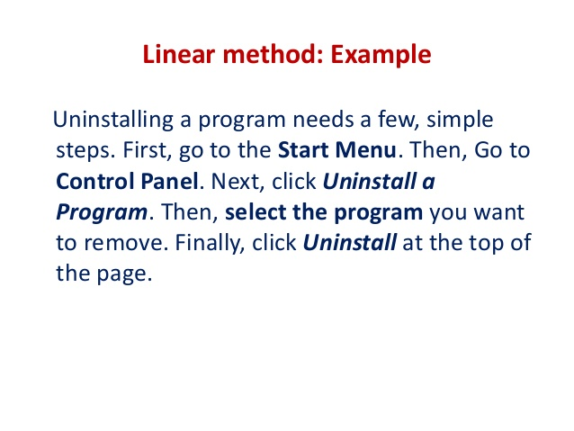

Slide 27
Chronological Order
This logical sequence refers to the narration of events in the order in which they occur in time, beginning with the first event, and going on to the next and so on.
It is very useful as it is quite easy and natural to record events in the order of their happening.
For ex. periodic report, progress report, etc.

Slide 28
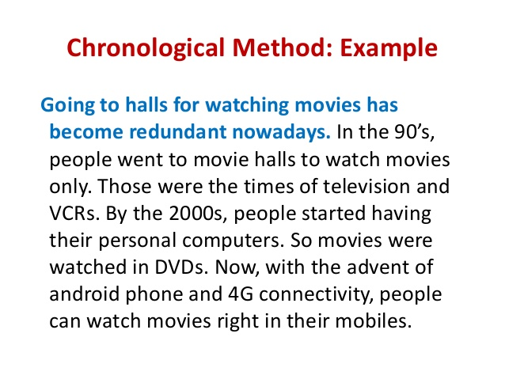

Slide 29
Expository/Explanatory Order
It is similar to deductive method.
The paragraph begins with a topic sentence.
In expository method, the writer tries to interpret, to discuss the same idea in several ways with the help of many instances, examples, etc.
In this method the writer explains the idea so as to make it more clearer.

Slide 30
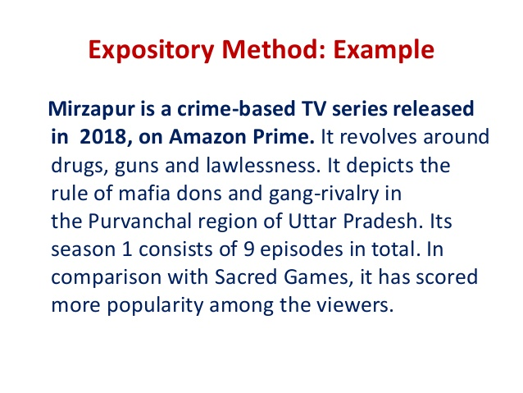

Slide 31
Interrupted Order
In interrupted method the writer may like to pause in order to elaborate on some ideas, people or events.
Purpose is to narrate an experience in a dramatic way
It adds more emphasis to the ideas in a sentence.
We can find such interrupted writing style mostly in narrative works such as fiction, stories, plays etc.

Slide 32
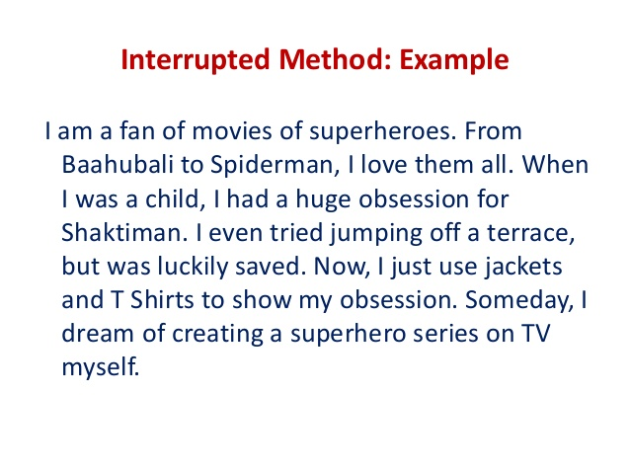

Slide 33
Probable Question Pattern
Elements of Paragraph development
Techniques of paragraph development
Components of paragraph development
Importance of Topic Sentence, Unity, Coherence & Emphasis
Tools of Coherence
Tools of Emphasis
Orders/Methods/Types of Paragraph
Difference between
Inductive & Deductive
Deductive & Expository
Chronological & Linear

Slide 34
THANKS

